Slide 1
Decisions & Debugging
Visual Basic

Slide 2
Table OF contents
Lecture context
IF then construct
Case construct
Debugging techniques
Single steps
Viewing variable contents

Slide 3

Lecture context
Be familiar with techniques used to make conditional decisions within a Program
Be able to decide when to use each technique presented here
Understand how to nest decisions and how to flowchart conditional decisions

Slide 4
Lecture context
There are three programming constructs that one can use, inline, iteration, and branching.
This lecture will look at the tools available in VB to make decisions and divert the flow of code based upon some input or the result of some operation. In instrumentation and control applications, the ability to react and process varying inputs is an essential feature.
Also, when writing programs, one needs to be able to debug and test them
The VB2010 IDE incorporates several useful tools for this and we will look at some of those.

Slide 5
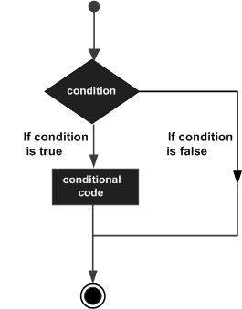
CONDITIONAL DECISIONS
Programs are not always sequential and may need conditional or unconditional branching constructs
Decisions made as a result of comms, calculations, user intervention etc.
Programmers need ways to make their programs flexible and adaptable
Two constructs are common to most programming languages

Slide 6
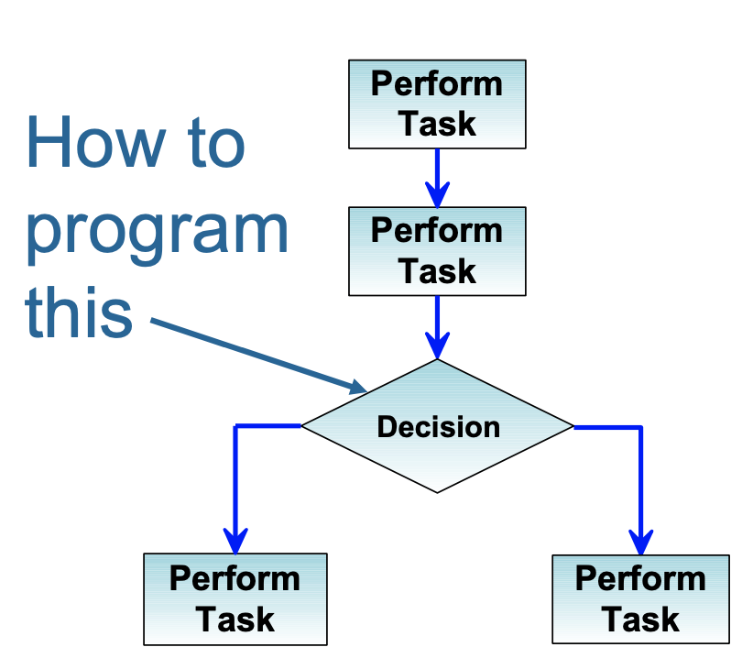
IF then construct
Conditional decisions and control of program flow
Comparison can be x>y, x<y, x = y or x not = y
Often best to avoid ‘=‘
The If-Then construct has
the basic form: If ( test condition) Then
Insert user code here
End If

Slide 7
IF then construct
Conditional decisions and control of program flow
Comparison can be x>y, x<y, x = y or x not = y
Often best to avoid ‘=‘
The If-Then construct has
the basic form: If ( test condition) Then
Insert user code here
End If

Slide 8
IF then construct
Able to test for multiple conditions using logical operators
Example 1: If(x=17ANDy=22) Then
Insert user code here
End If
Example 2: If(x = 2 OR x = 3 OR y = 2) Then Insert user code here
End If

Slide 9
CONDITIONAL DECISIONS
Programs are not always sequential and may need conditional or unconditional branching constructs
Decisions made as a result of comms, calculations, user intervention etc.
Programmers need ways to make their programs flexible and adaptable
Two constructs are common to most programming languages

Slide 10
Nested IF then construct
May be nested
NOTE: 2 ‘If-Then’ requires 2 ‘End If’ – use comments to track them
intOutput only incremented IF BOTH intInput1 and intInput2 = 1
If intInput1 = 1 then
If intInput2 = 1 Then intOutput = intOutput + 1
End If ‘intInput2 End If ‘intInput1

Slide 11
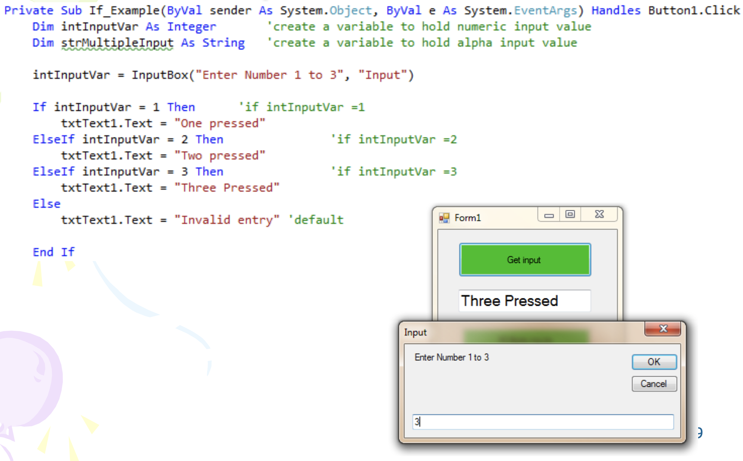
Code Together example

Slide 12
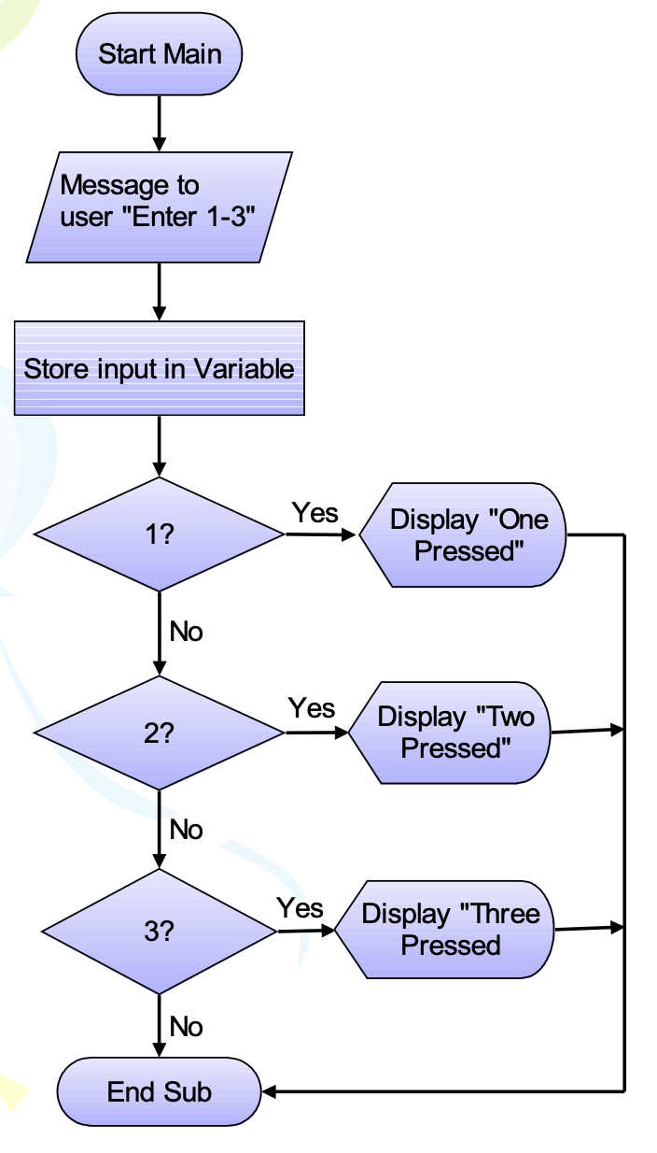
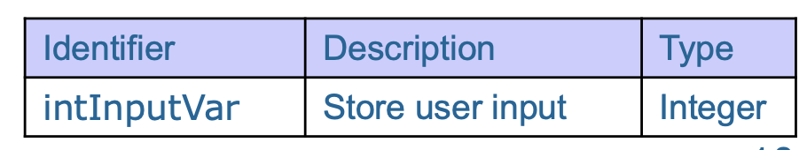
LOGIC BEHIND Code Together example

Slide 13
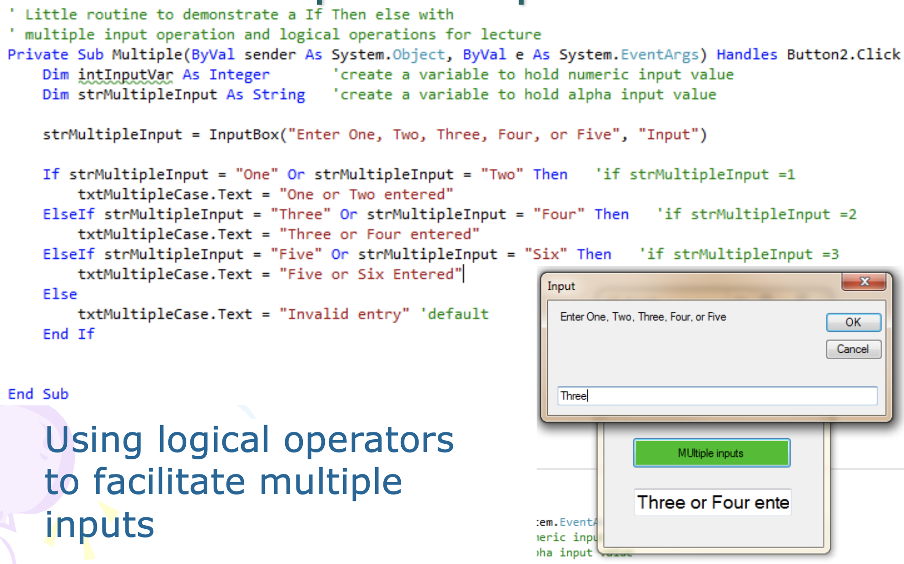
Example if-then-else with multiple comparisons

Slide 14
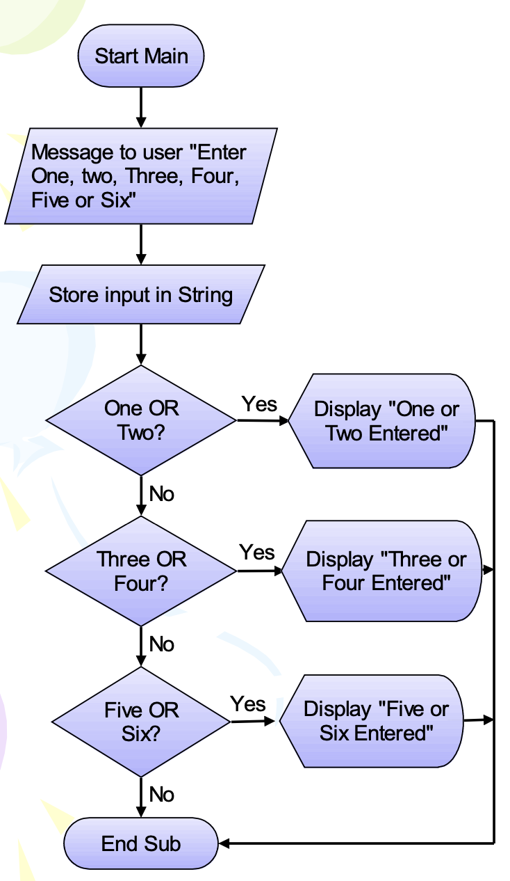
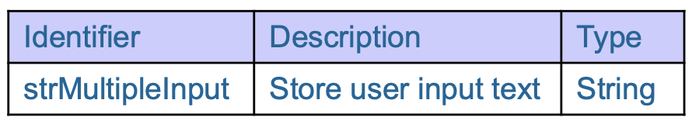
Logic behind Example if-then-else with multiple comparisons

Slide 15
Alternative to if else
Used as an alternative to a series of If / else
Each ‘expressionlist’ is a list of one or more conditions to be checked
Select Case testexpression Case expressionlist1
[statementblock-1] Case expressionlist2
[statementblock-2].
.....
Case Else
[statementblock-n]
End Select

Slide 16
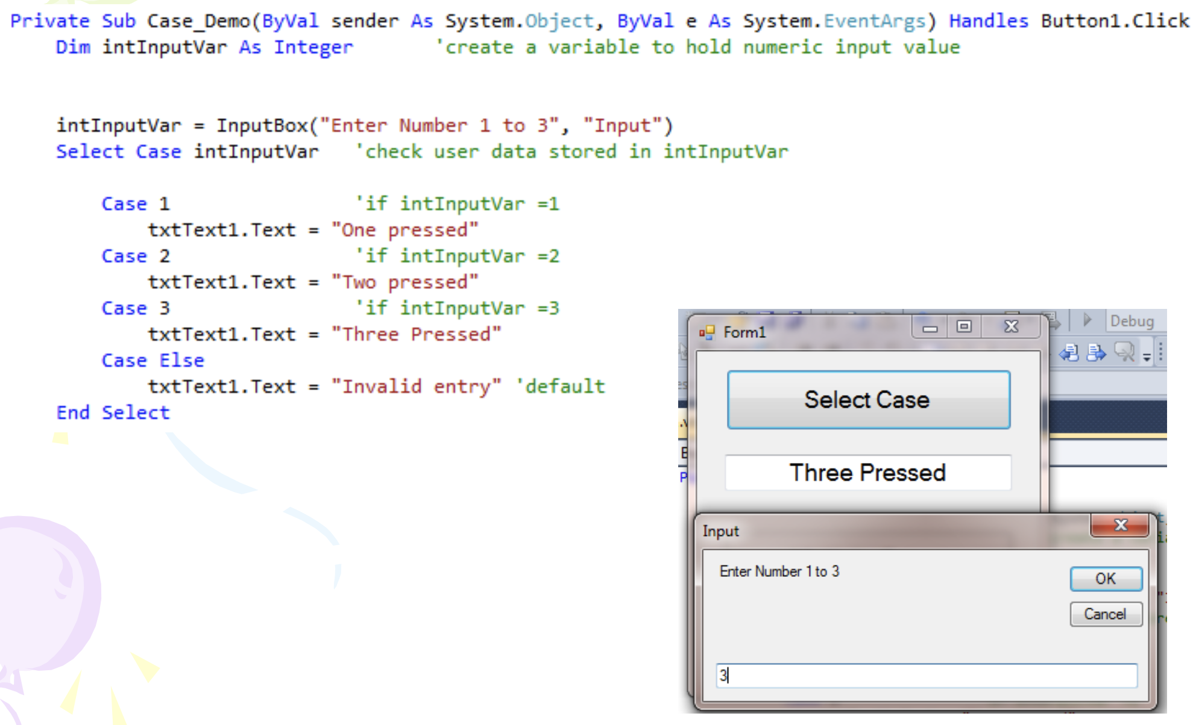
CODE TOGETHER EXAMPLE

Slide 17
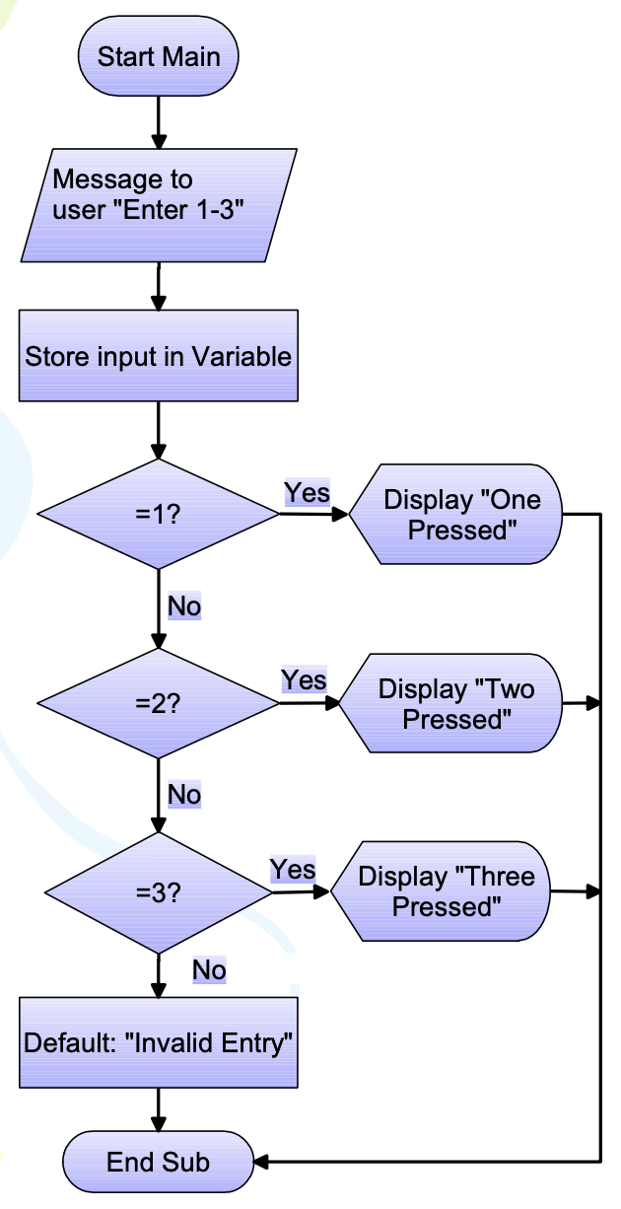
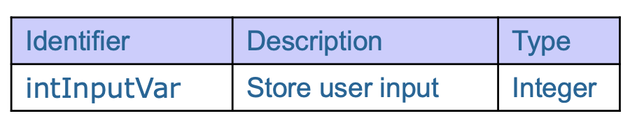
Logic behind CODE TOGETHER EXAMPLE

Slide 18
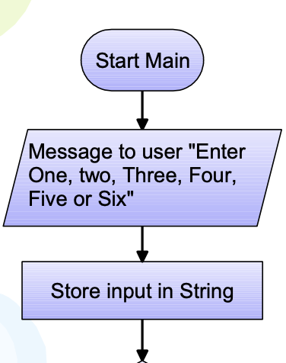
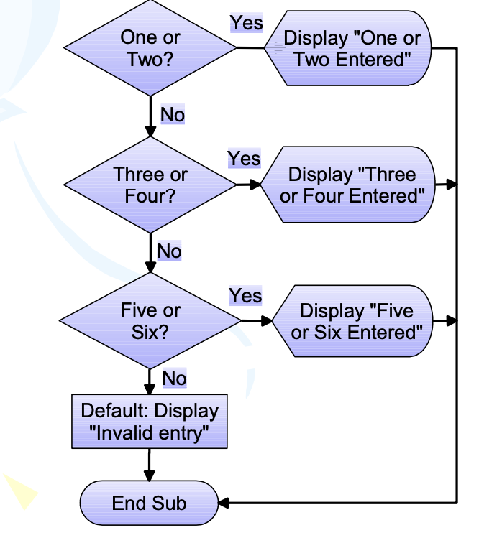
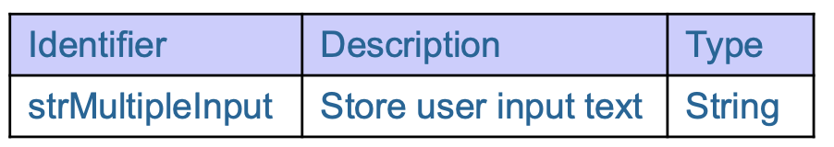
CODE together example

Slide 19
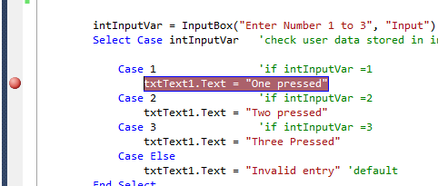
Debugging techniques
These are essential techniques for use when writing code – write small sections and TEST each before moving on
Execution halted with breakpoints
Click to left side of code – line highlighted in red and red dot shown
Code runs line-by- line until breakpoint reached
Similar to other IDE’s like Intellij or visual studio code

Slide 20
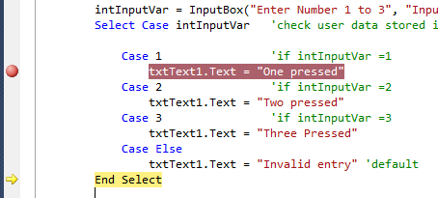
Single steps
After breakpoint has paused the code, single step by pressing F11
Code lines run one at a time which is highlighted in yellow
Hover mouse over variable to view its contents
Code runs line-by- line until breakpoint reached Or view in one of the debugging windows

Slide 21
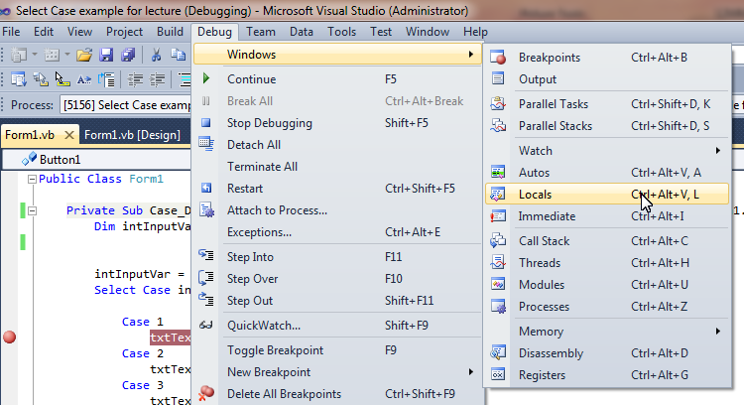
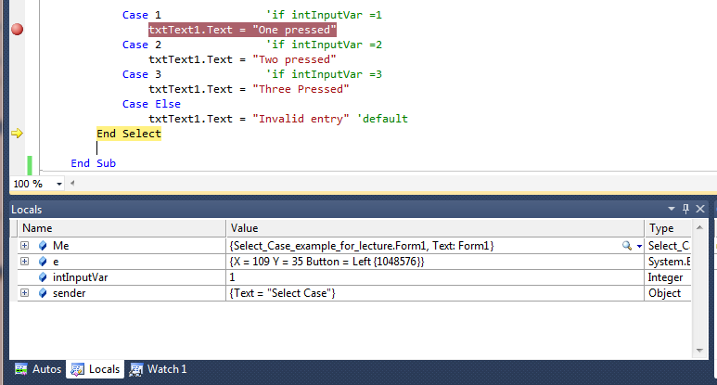
Viewing variable contents
Local variable contents can be displayed in locals window – updated on F11 press as code steps
C Run code to breakpoint and select (only available when running debug) Debug>Windows>Locals

Slide 22
Exercise (10 – 15 mins)
Submit this piece of code for this exercise for this particular chapter
Feel free to expand on this, but minimally your app should have the minimal functionally as shown in the screenshot here

